Slide 1



Slide 2
CollegeAdvantage Is Ohio’s 529 Plan, One Of The Nation’s Top Rated Plans.
Ohio offers two plans;
both are variable savings plans.
Ohio is the f if th largest state sponsor of 529 plans in the country.*
Administered by the Ohio Tuition Trust Authority (OTTA).
* Strategic Insight
OTTA is a state agency under the Ohio Department of Higher Education.
Investments overseen by an 11-member board.
Professional investment management by leading f inancial f irms.

Slide 3
529 Plans Were Created To Help
Make College Doable.
Investment earnings grow tax-free.
Withdrawals are not taxed when used for qualif ied expenses.

Slide 4
The Top Three Reasons To Use Ohio’s
529 Plan? Taxes. Taxes. And Taxes.
The compounding power of tax-free growth.
(Assumptions: approximately $2,500 per year for 18 years, 5% annual earnings, 15% federal tax rate, and 6% state tax rate.)
Use our tax benefit tool at CollegeAdvantage.com to calculate different assumptions.

Slide 5
The Top Three Reasons To Use Ohio’s
529 Plan? Taxes. Taxes. And Taxes.
Tax-free withdrawals when you use the funds for college.
* Please read the Offering Statement for additional details about qualified higher education expenses.

Slide 6
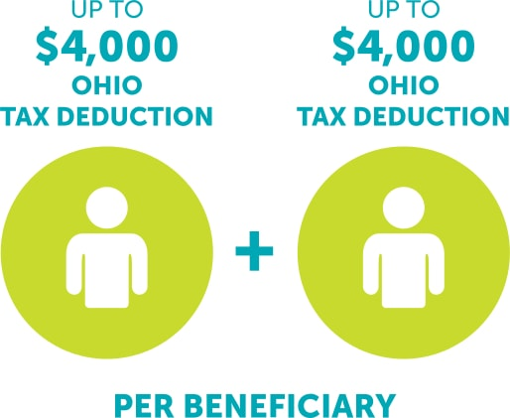
The Top Three Reasons To Use Ohio’s
529 Plan? Taxes. Taxes. And Taxes.
State of Ohio tax deduction each year.

Slide 7
Save In Ohio’s 529 Plan And Go To College In Any State.

Slide 8
What About Gifting?
A CollegeAdvantage 529 is the perfect way for grandparents, extended family, and friends to have an impact on your child’s future.

Slide 9
What About Gifting?
Contribute to an existing account online
Open a 529 for someone else
Send gift announcements with your 529 gift

Slide 10
What If My Child Doesn’t
Attend College?
Leave the funds for later use.
Transfer all or part of the funds to another family member.
Withdraw the money, although taxes on the earnings will be due, as will a 10% federal tax penalty only on the earnings.

Slide 11
What If My Child Gets A Grant
Or Scholarship?
Even with a 529 plan, your child can still apply for most scholarships and grants.
Financial aid packages rarely cover 100%.
Funds equal to a scholarship can be withdrawn without the 10% federal tax penalty, but the earnings portion will be taxed as income.
Attendance at a U.S. military academy is treated the same as a scholarship.

Slide 12
Does A 529 Plan Affect Eligibility For Federal Financial Aid?
Federal and school-funded financial aid calculations are complicated!
If anyone other than a parent owns the account – significant effect requiring careful planning, so consult a legal, financial, or tax advisor to learn more.
Be aware: Most financial aid comes in the form of loans (not grants), which must be paid back.

Slide 13
Here Are Sources Of Information
About 529 Plans And College Planning.
CollegeAdvantage:
CollegeAdvantage.com
1-800-AFFORD-IT
Learn about and compare 529 plans:
www.CollegeSavings.org
www.SavingForCollege.com
College planning and career research for K-12 and college students and general information for residents of any state and Ohio-specific information:
www.OhioHigherEd.org
www.OhioMeansJobs.com
U.S. Department of Education, Federal Student Aid College planning, financial aid information, FAFSA instructions and form, and more:
https://studentaid.ed.gov
Others who can help you prepare for college:
Middle- and high-school counselors
College financial aid officers and admissions representatives
Taxes and 529s, gift-tax information, estate planning, and financial planning:
Consult your tax accountant, financial planner,
and/or legal counsel

